Slide 1


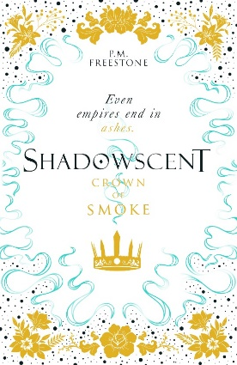

SHADOWSCENT
Crown of Smoke
P. M. Freestone
Crown of Smoke is the thrilling conclusion to the Shadowscent duology which began with The Darkest Bloom. In a world ruled by scent, the provinces are readying for war. Who will be left when the smoke clears?
Discussion Questions
In the first book, Ash and Rakel share the narrative between them. In the second, they are joined by Luz. How does the use of different narrative forms affect the way you experience a story?
The Order of Asmudtag have a terrible decision to make when it comes to curing the Rot – a cure that cannot be made in large quantities. If you can only save a few people, do you save anyone? Who gets to survive? What would you do in this situation?
Discuss the language around scent used in this book, such as a bragging person being “all smoke and no scent.” What other phrases jumped out while you were reading? What other phrases in our daily life could be adapted to involve language around scent and smell?
Projects for Home
People have been making perfumes for thousands of years. Research the history of perfumery – where do different scents come from? Where is famous for perfume? Write a one page summary of the most interesting facts that you find.
What are your favourite scents? Write a list, and include what they make you think of. Does a certain smell make you think of school? Home? Your best friend? Now, imagine a made-up character. What are their favourite scents and why?
Pick a different sense – touch, hearing, sight or hearing. Create a world where this is most important thing: what would this world look like? Write a story using this.

