Slide 1
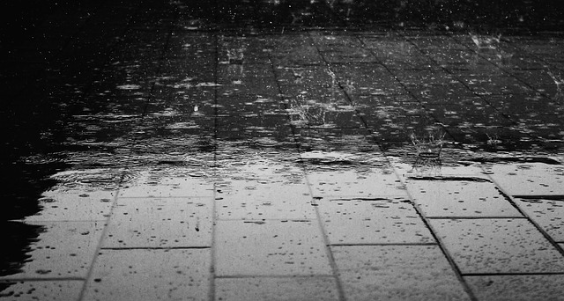
How can you stay dry on a rainy day?

Slide 2
Wear waterproof clothes and wellies!

Slide 3
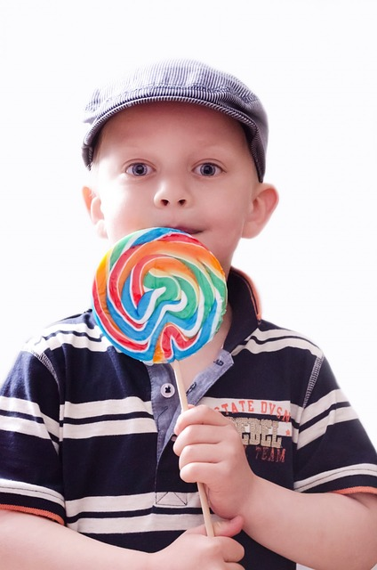
What should you do after eating sweets?

Slide 4
Brush your teeth!

Slide 5
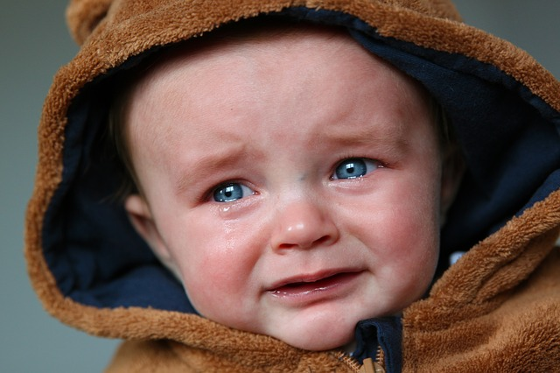
What makes you feel better when you are sad?

Slide 6
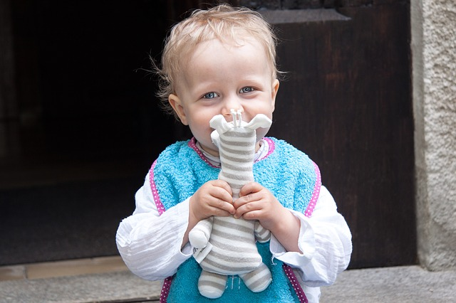
Having a cuddle with your teddy!

Slide 7
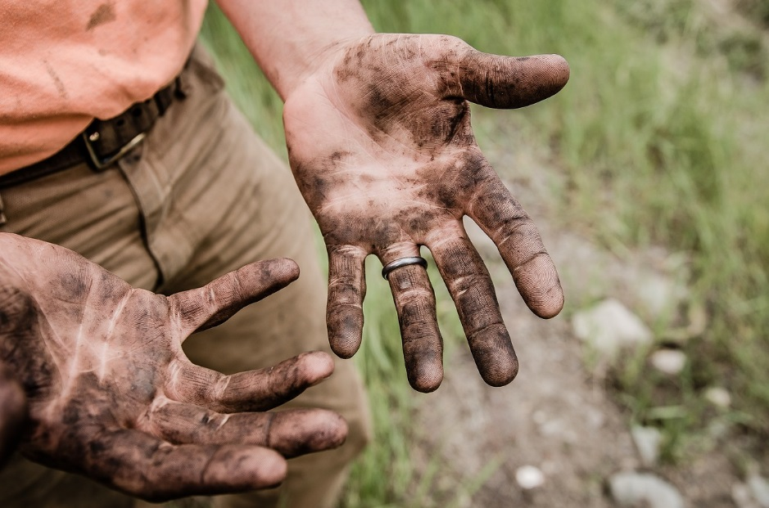
What should you do when your hands are dirty?

Slide 8
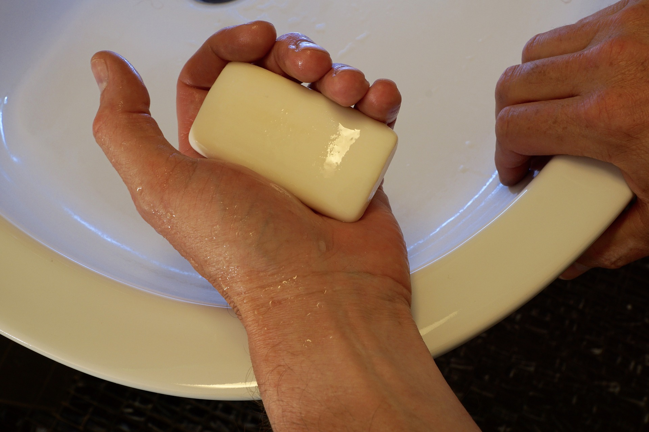
Wash them with soap and water!

Slide 9
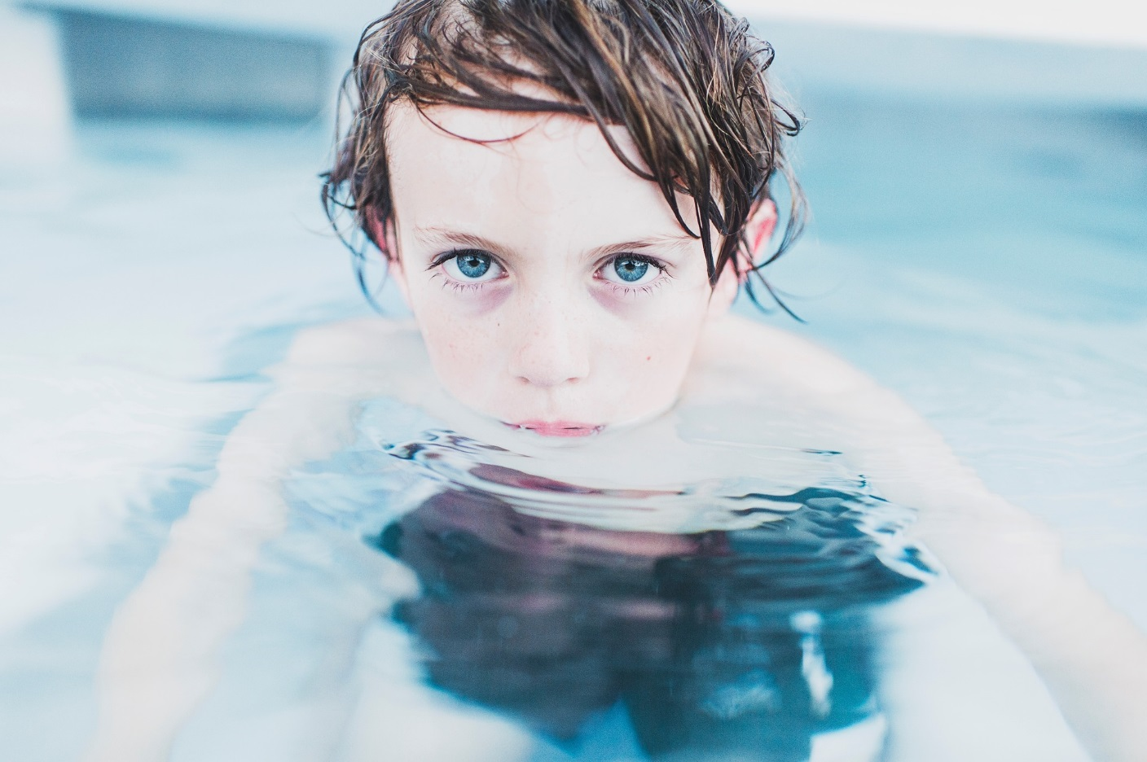
What should you do to get warm when you are wet?

Slide 10
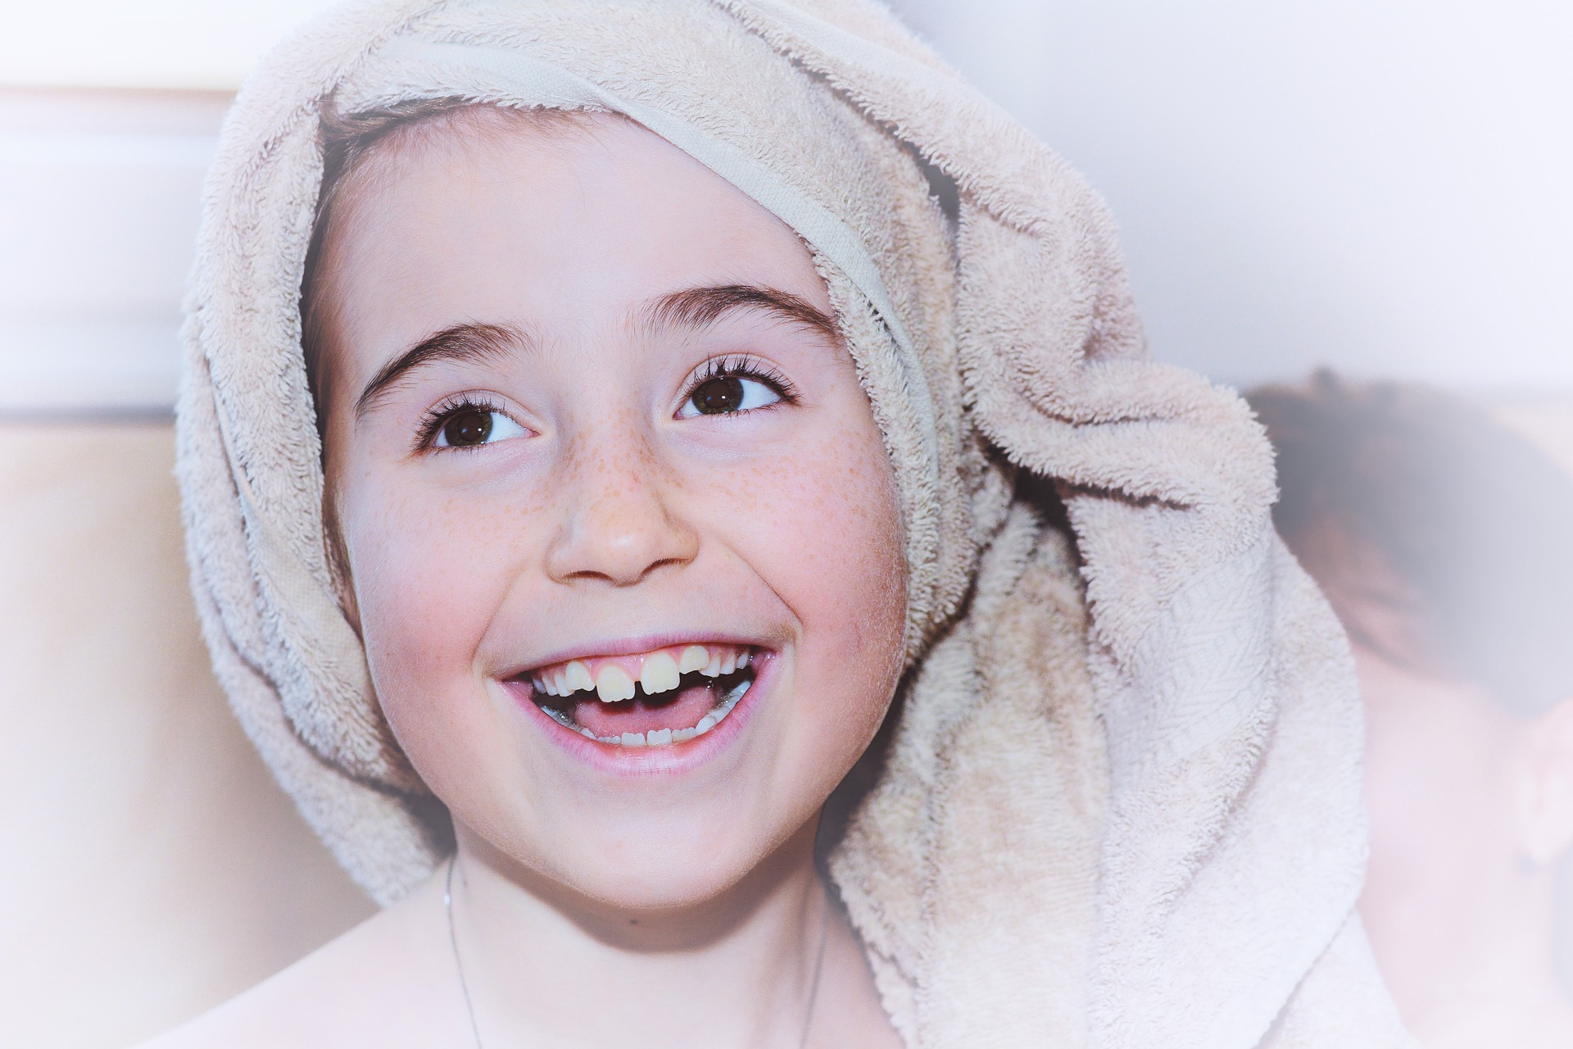
Dry yourself with a towel!

Slide 11
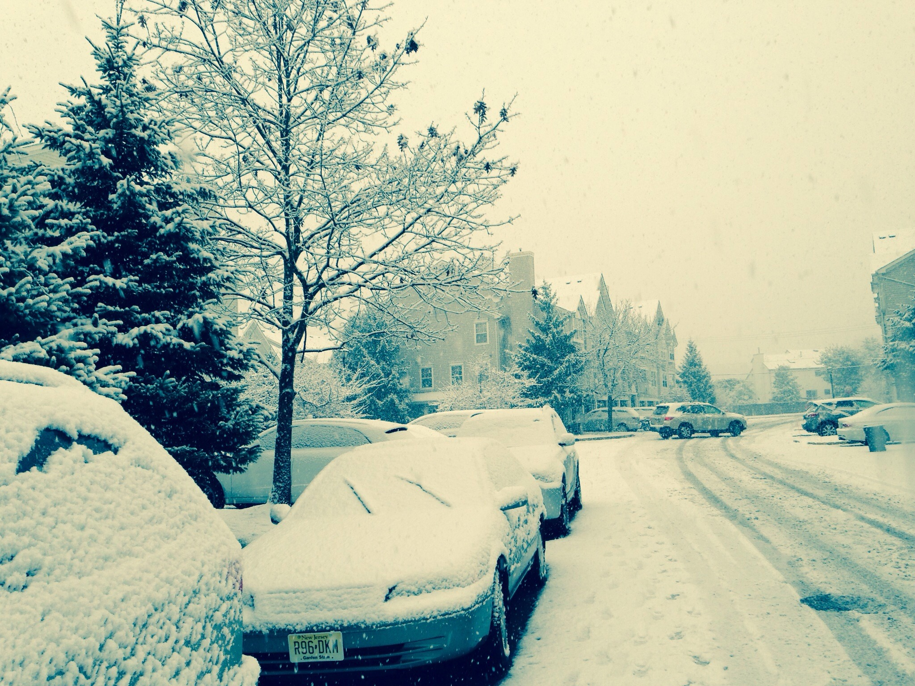
What should you do to stay warm on a cold day?

Slide 12
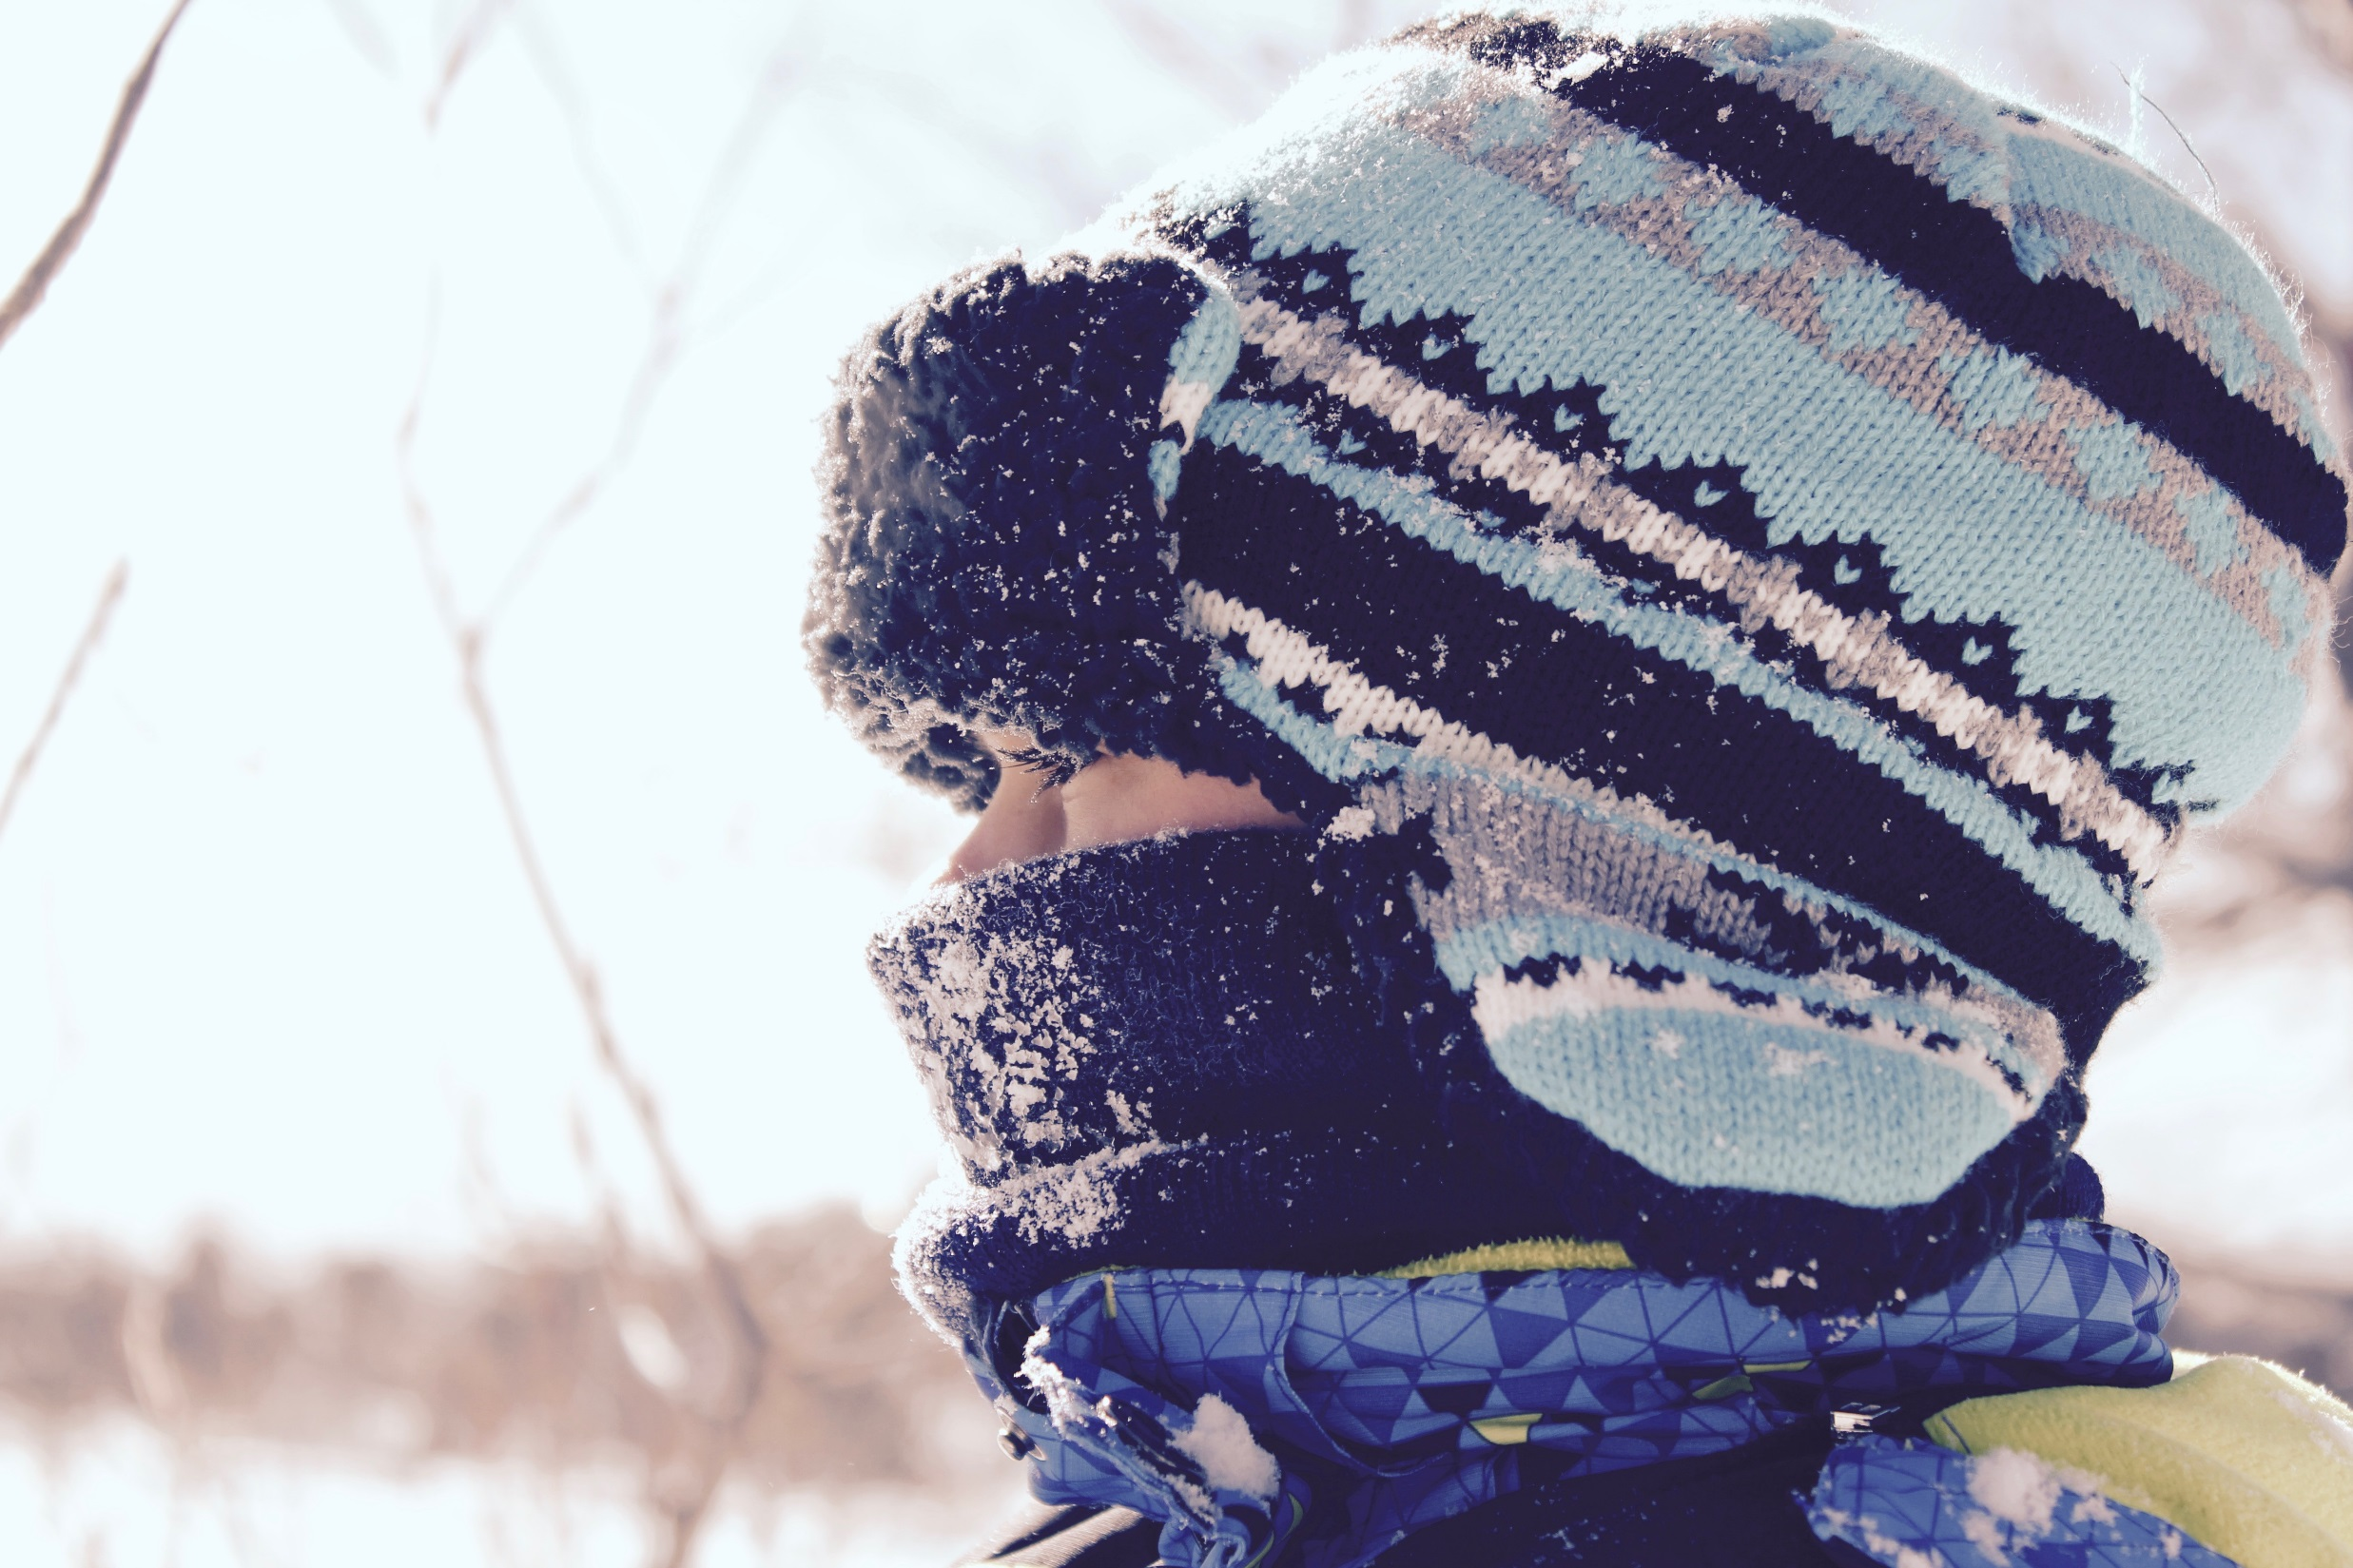
Wear warm clothes!

Slide 13
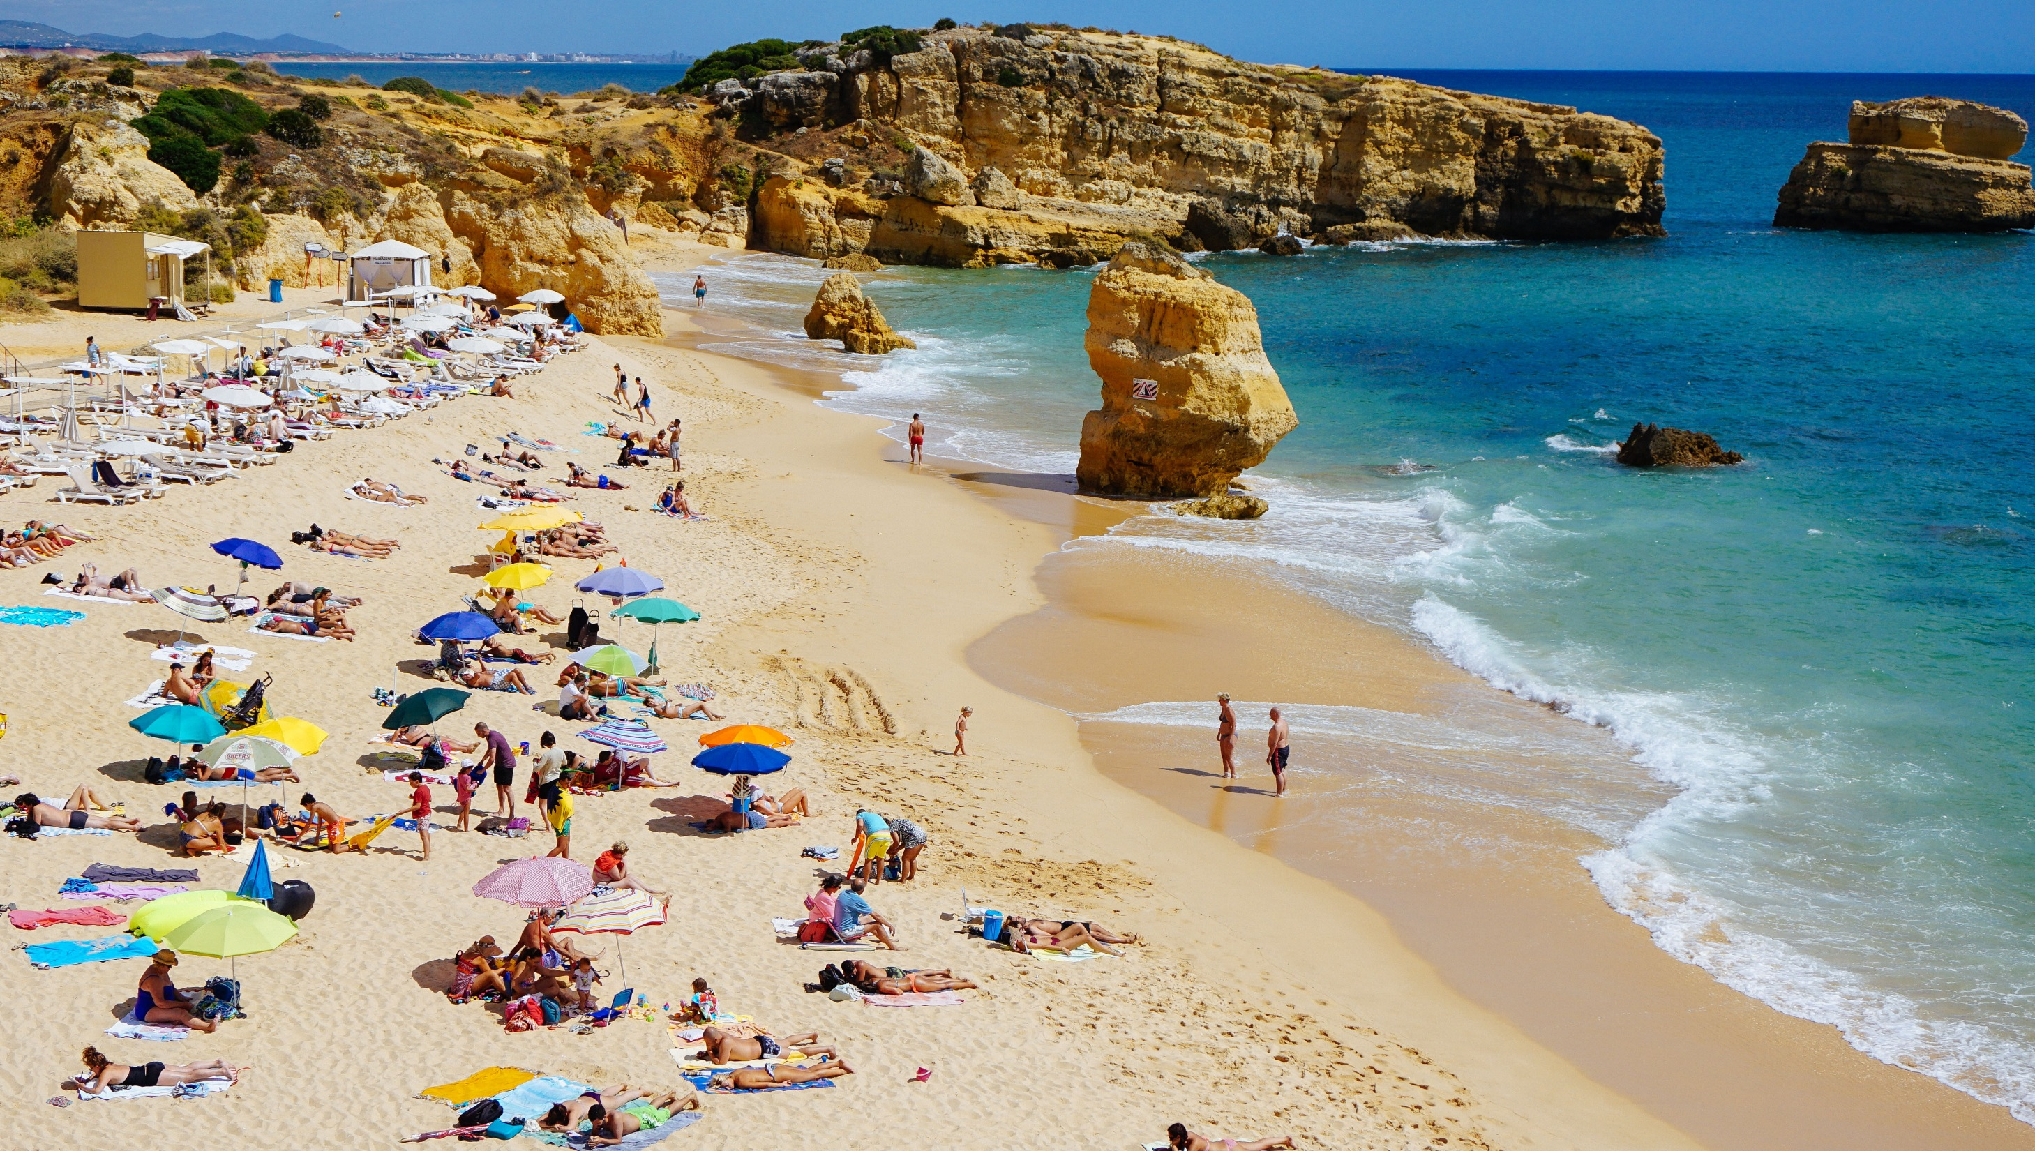
How can you stop yourself getting sunburnt at the beach?

Slide 14
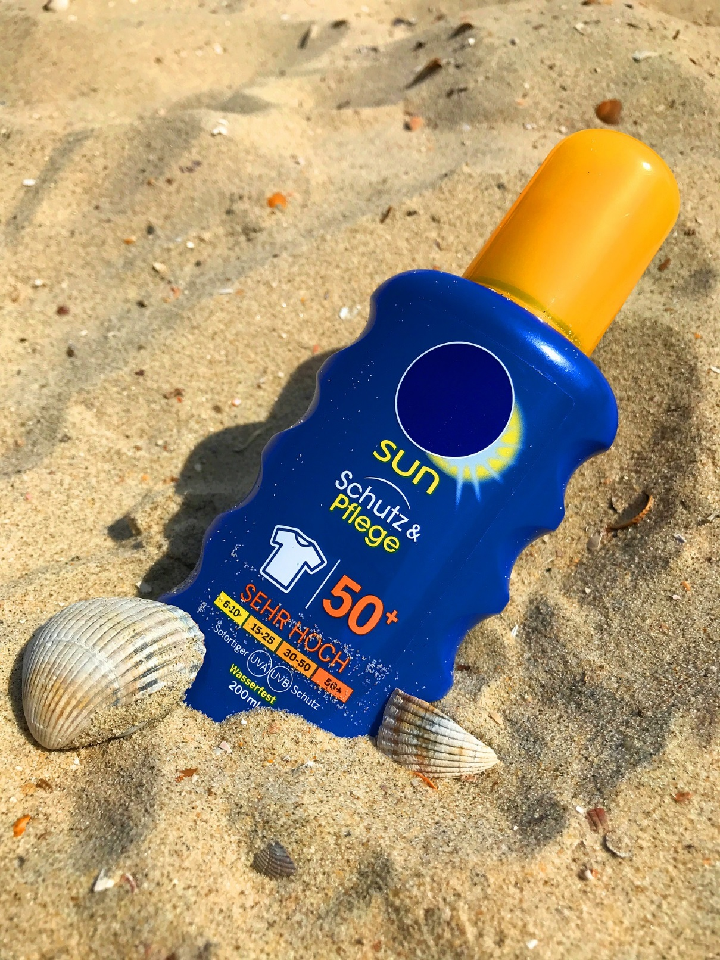
Wear sunscreen!

Slide 15
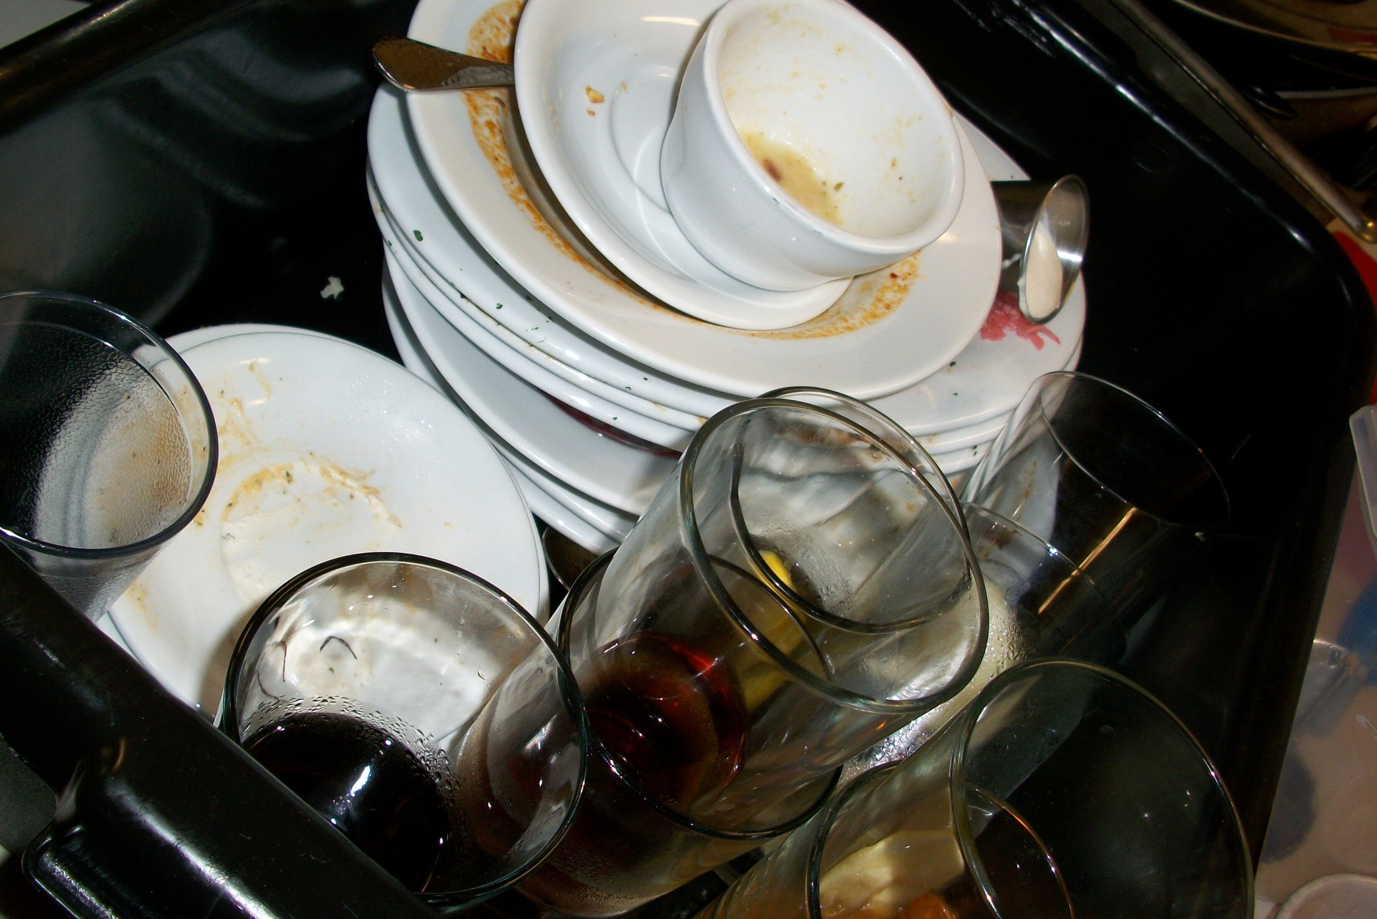
What should you do with dirty dishes?

Slide 16
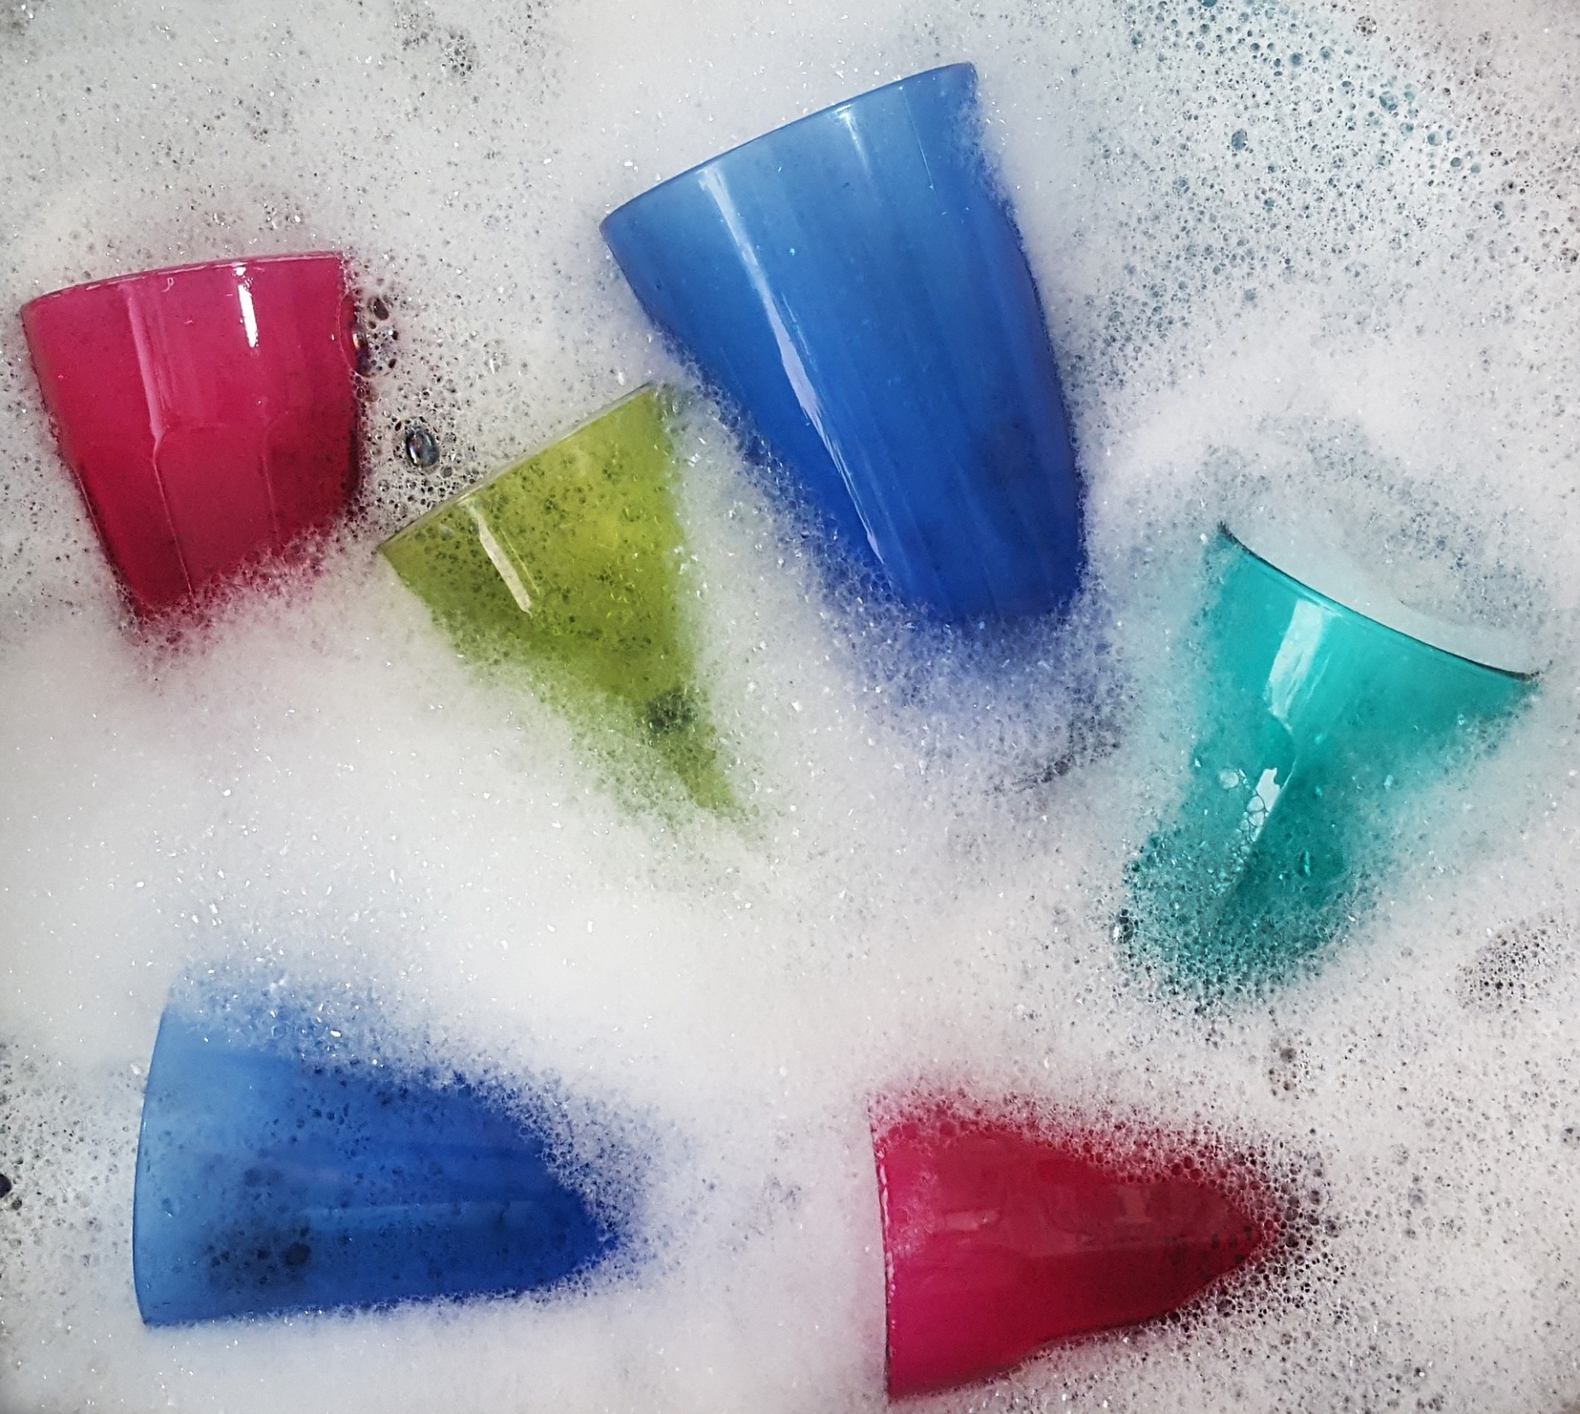
Clean them with washing-up liquid!

Slide 17
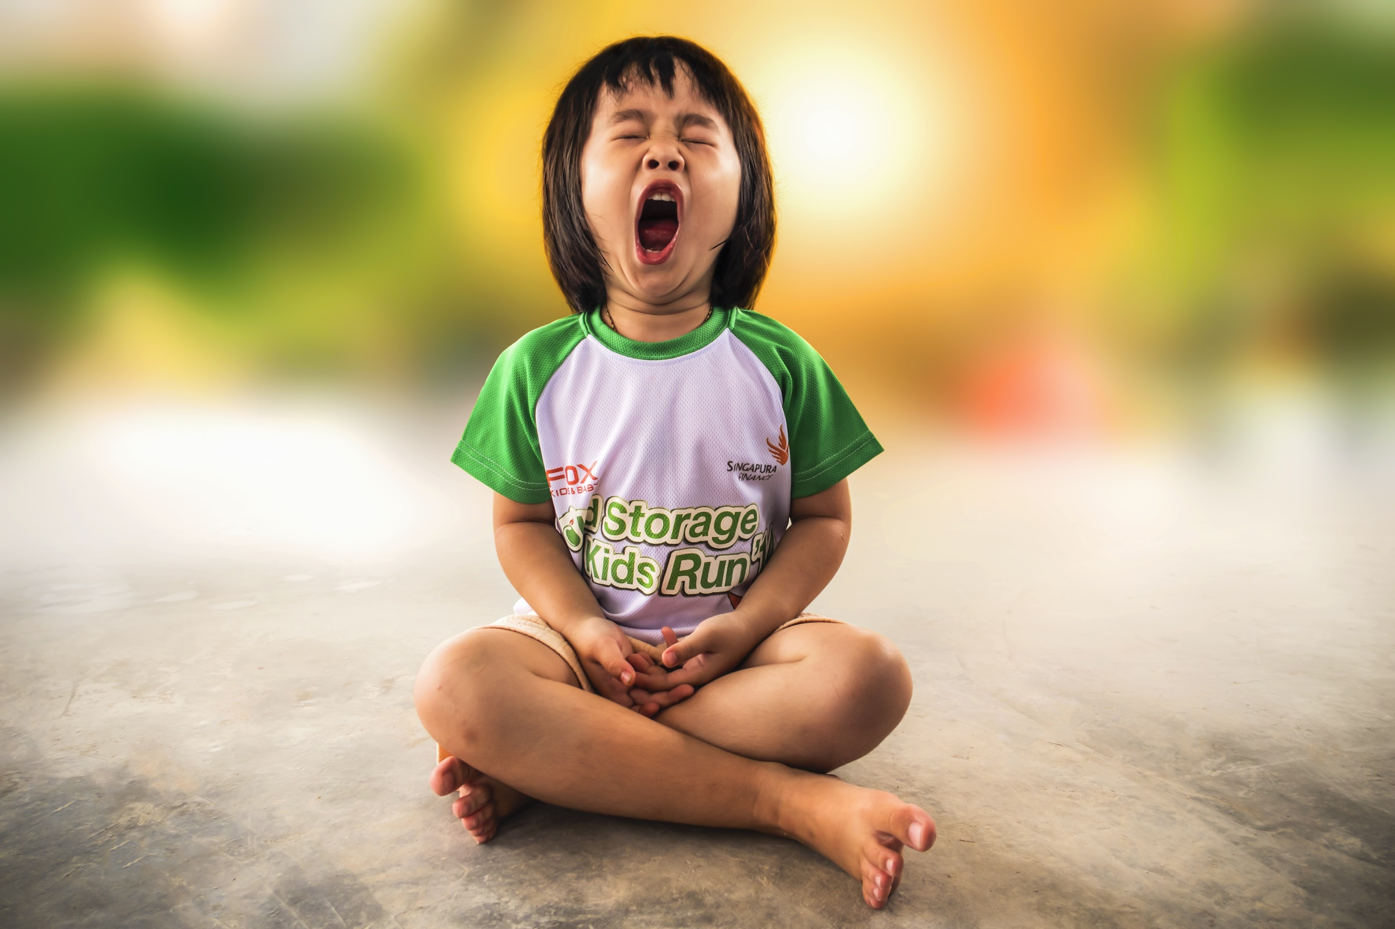
What should you do when you are tired at the end of the day?

Slide 18
Go to sleep in your bed!
Images from shutterstock.com and pixabay.com

