Slide 1
Photos © Dale Cherry for The Reading Agency with thanks to Crawley Library
Notes:
Please note:
Illustrations in this presentation are copyright of Quentin Blake so please do not drag and drop images to use in other documents.
The links within this presentation will only work when you are in slide show mode. You will need access to the internet when using this slide show for the links to work.
Please customise, add or remove slides to reflect how the Summer Reading Challenge is run locally.
Full details of the Roald Dahl Museum offer:
The Roald Dahl Museum has kindly offered free weekend entry to EVERY child who is taking part in the Summer Reading Challenge during the summer holiday period (25 June to 4 September, 10 weekends). To take advantage of this offer, children will need to bring with them either their collector folder or an item that shows they are taking part in the Summer Reading Challenge (e.g. the bookmark or wristband). The invitation will not be proof of participation. Older children taking part through Reading Hack will need to show their Reading Hack lanyard or log book. Any adults accompanying children will have to pay. Visitors can ring the museum to pre-book their admission and mention that they have a child participating in the Summer Reading Challenge (they’ll will still need to bring proof of their participation with them) or, if not pre-booked, they’ll just need to show folder, bookmark or wristband when buying tickets on the door. The museum is open Saturday and Sunday 11am to 5pm Normal admission prices are: Adults £6.60 Children 5 to 18 £4.40 Children under 5 Free

Slide 2
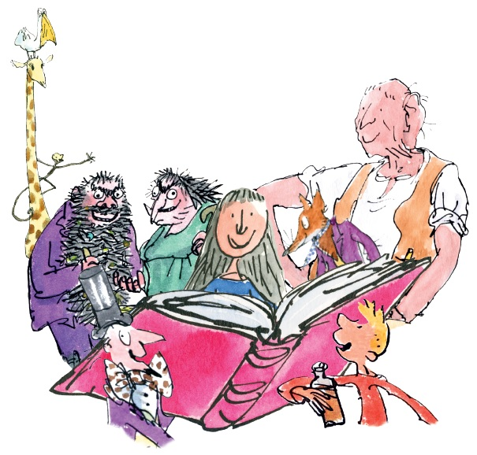
Bet you know who these characters are?

Slide 3
Join Matilda, Willy Wonka and the BFG in

Slide 4
Your Challenge
Read six books from your library
Collect cards for your
Big Friendly Read
Collectors folder
Some cards are smelly!

Slide 5
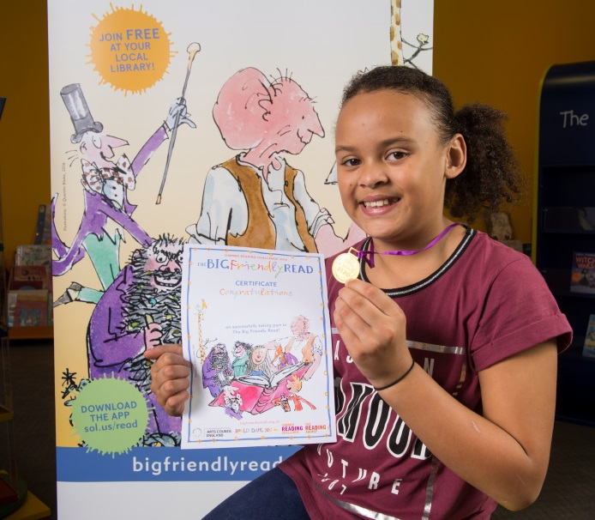
Complete the Challenge and you’ll get your own medal and certificate

Slide 6
Take part in the Challenge and enjoy a phizz-whizzing trip to the Roald Dahl Museum and Story Centre for free!

Slide 7
Visit the website:
www.bigfriendlyread.org.uk
Loads of games and competitions
Use the Book Sorter to choose and recommend books to read
Download the App: www.sol.us/read
Unlock secret video clips and games

Slide 8
Take part this summer
Insert local library address
Insert your opening hours
Insert date the Challenge begins at the library
It’s fun! It’s free! It’s local!

Slide 9
Trailer
Notes:
Click on the centre of the picture to play the trailer – this will only work when you are in slide show mode
The trailer is also available on the children’s website and the main Reading Agency website.
If you can’t access YouTube then contact summerreadingchallenge.org.uk and we will arrange to let you have the trailer in an alternative format

Slide 10
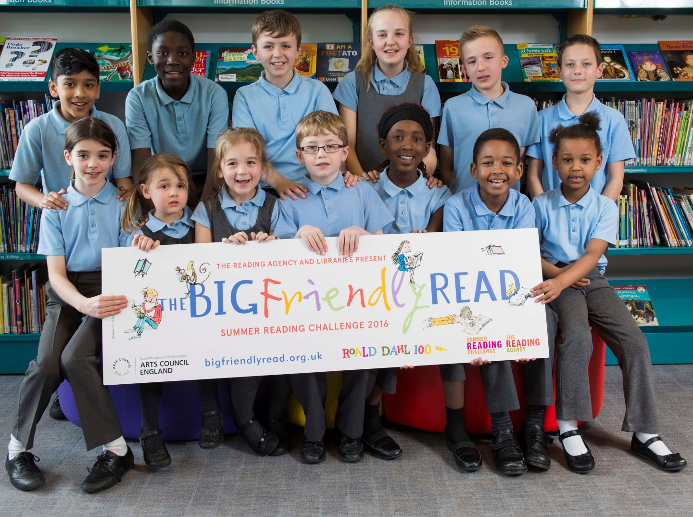
Photos © Dale Cherry, for The Reading Agency
Notes:
Please note:
The links within this training presentation will only work when you are in slide show mode.
You will need access to the internet when using this slide show for the links to work.
Please customise, add or remove slides to reflect how the Summer Reading Challenge is run locally.

