Slide 1
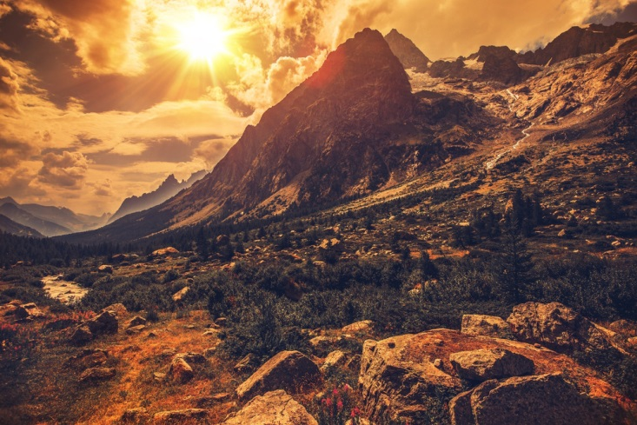
Landscapes
By Hilary White

Slide 2
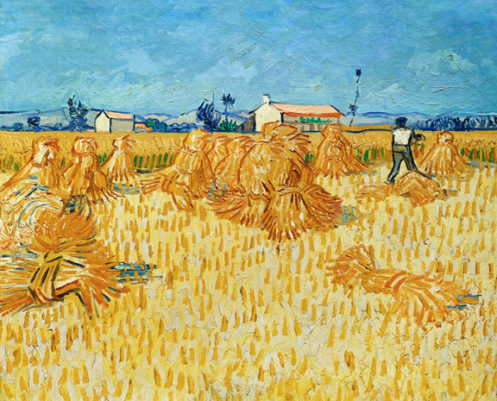
Vincent van Gogh – The Harvest

Slide 3
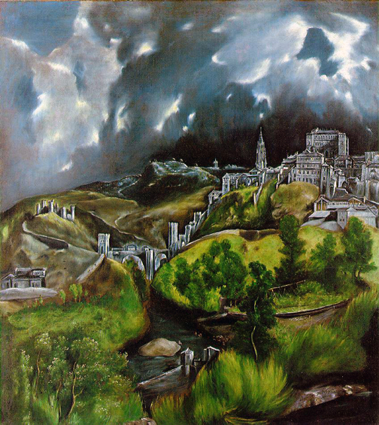
El Greco – View of Toledo

Slide 4
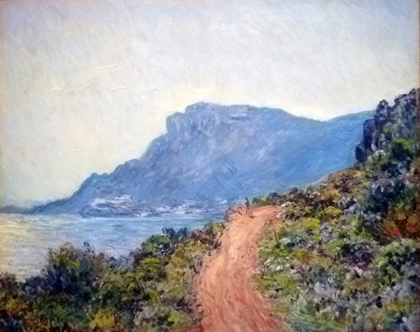
Claude Monet – La Corniche

Slide 5
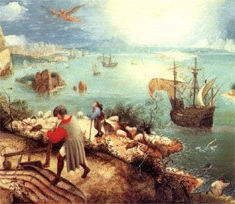
Pieter Bruegel – Landscape with the Fall of Icarus

Slide 6
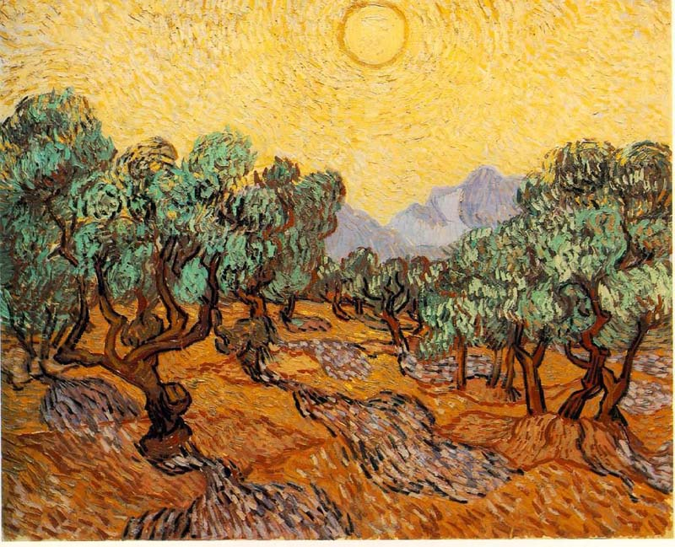
Vincent van Gogh – Olive Trees with Yellow Sky and Sun

Slide 7
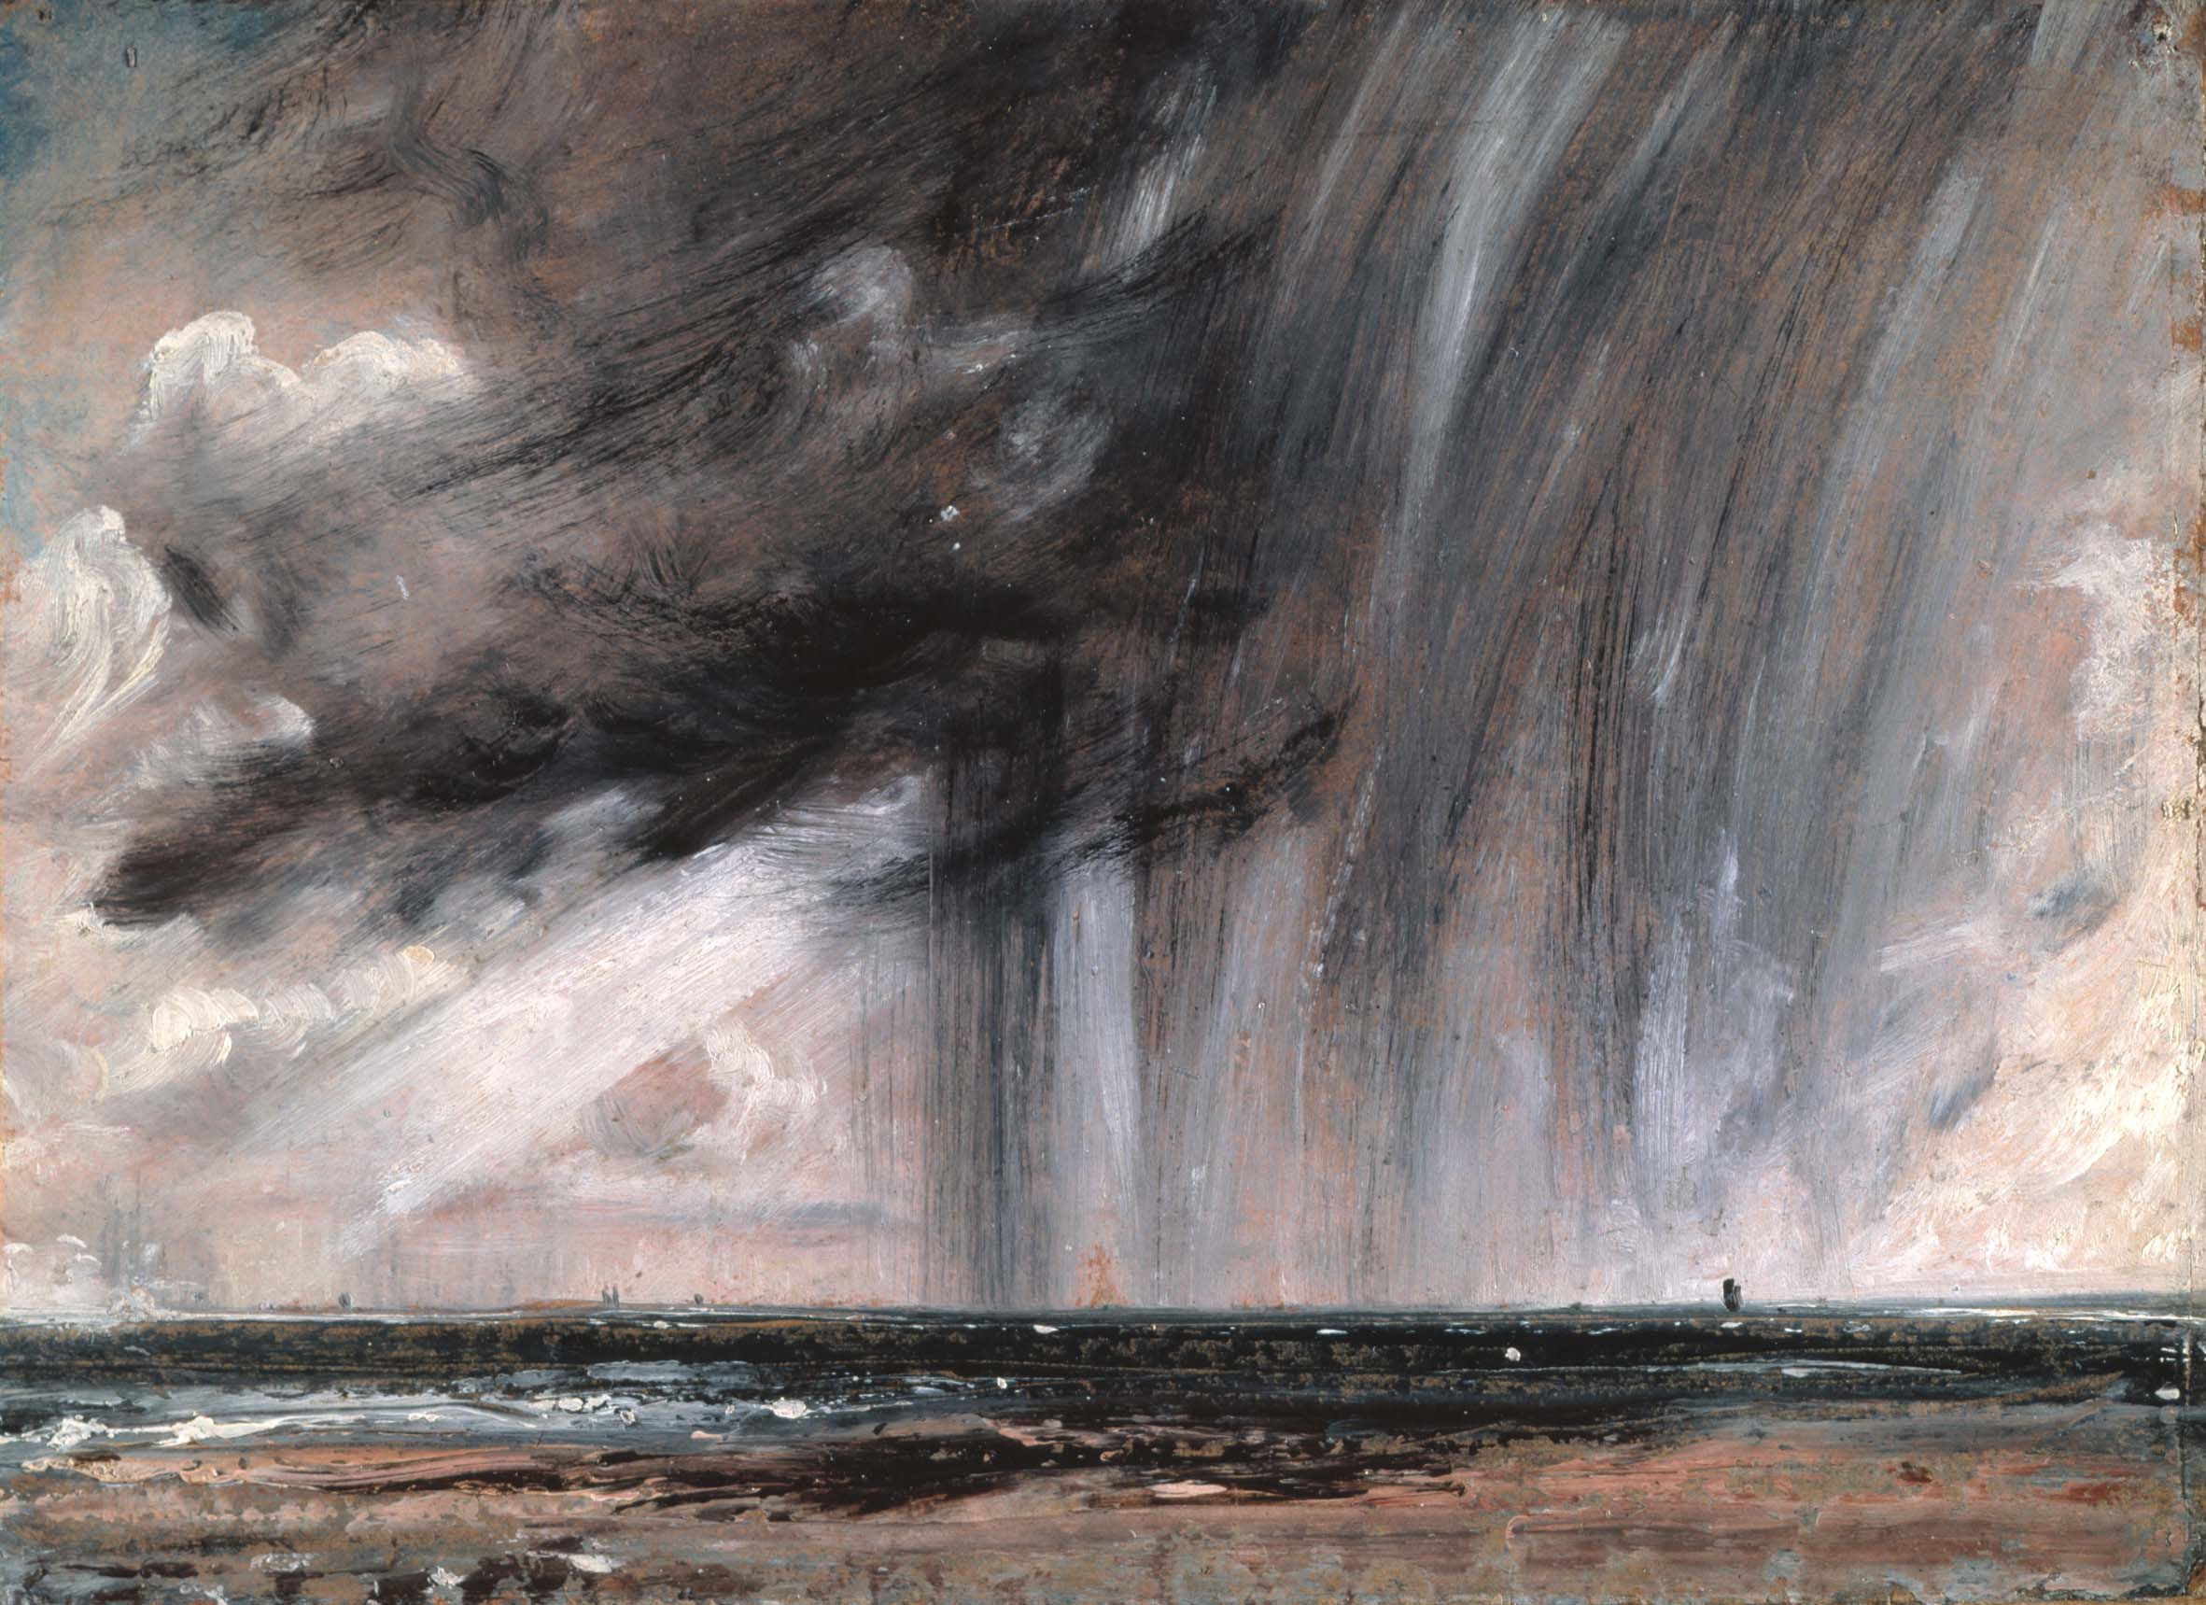
John Constable – Seascape Study with Rain Cloud

Slide 8
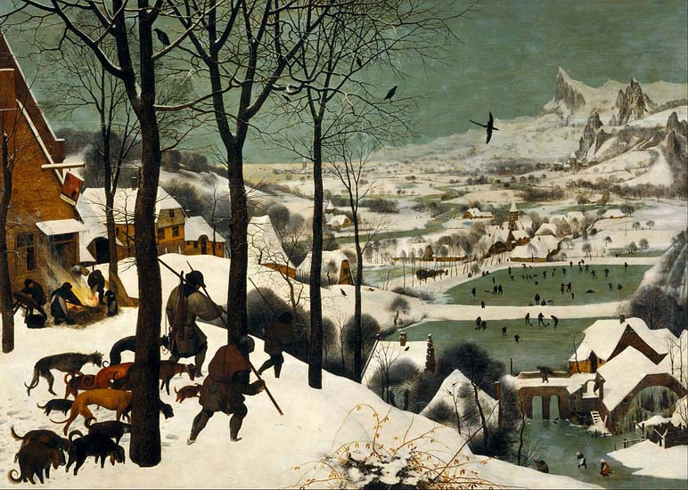
Pieter Bruegel – Hunters in the Snow

Slide 9
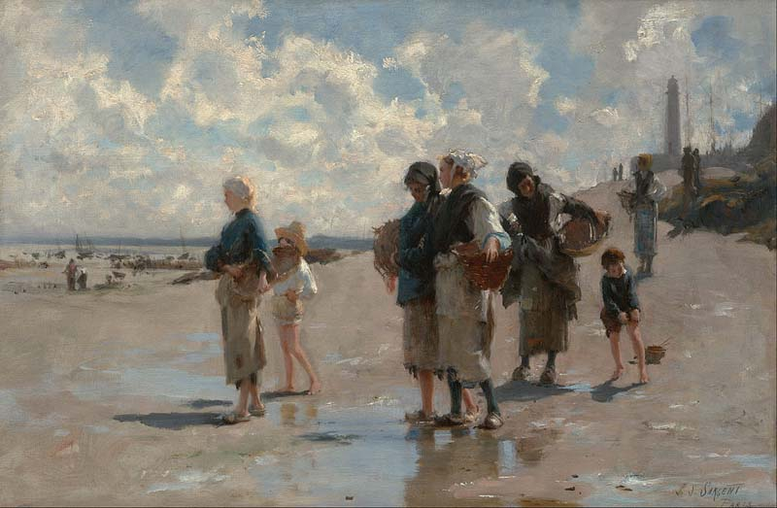
John Singer Sargent – Oyster Gatherers at Cancale

Slide 10
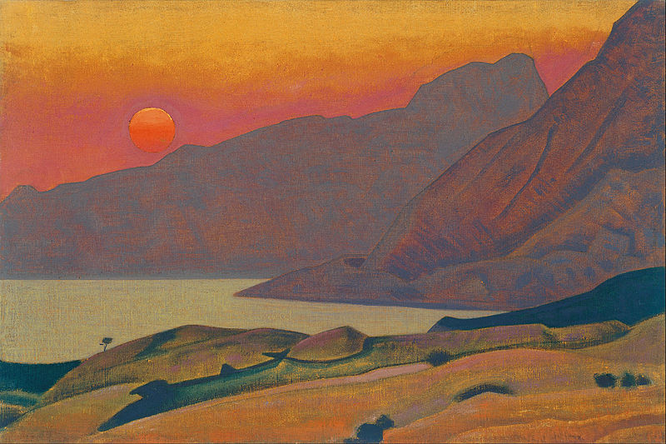
Nicholas Roerich – Monhegan, Maine

Slide 11
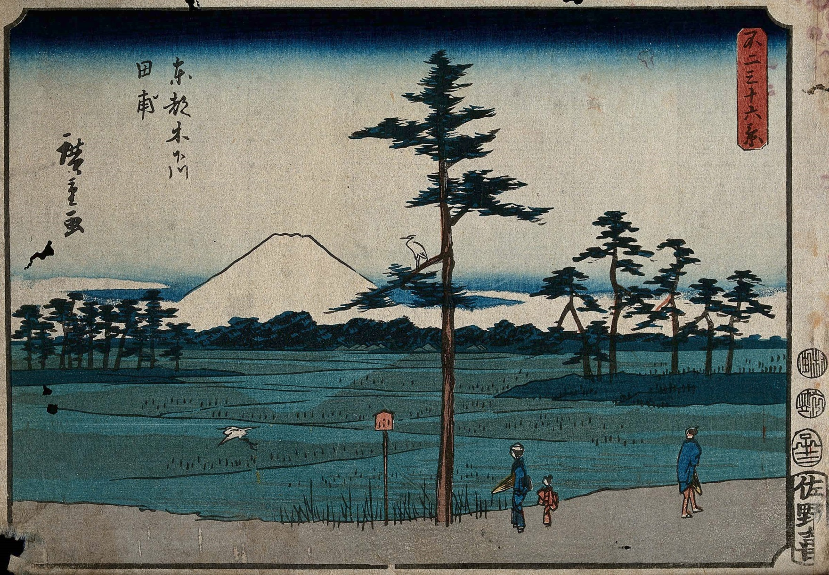
Utagawa Hiroshige – Mount Fuji seen from Kinegawa

